Slide 1
DESIGN AND ANALYSIS OF ALGORITHMS
UNIT 1

Slide 2
What is an algorithm?
An algorithm is a sequence of unambiguous instructions for solving a problem, i.e., for obtaining a required output for any legitimate input in a finite amount of time.
problem
algorithm
“computer”
input
output

Slide 3
Example of A computational problem: sorting
Statement of problem:
Input: A sequence of n numbers <a₁, a₂, …, a_{n}>
Output: A reordering of the input sequence <a´₁, a´₂, …, a´_{n}> so that a´_{i} ≤ a´_{j} whenever i < j
Instance: The sequence <5, 3, 2, 8, 3>
Algorithms:
Selection sort
Insertion sort
Merge sort
(many others)

Slide 4
Selection Sort
Input: array a[1],…,a[n]
Output: array a sorted in non-decreasing order
Algorithm:
for i = 1 to n
swap a[i ] with smallest of a[i ],…a[n ]
Notes:
The algorithm is given *very* informally here. Show students the pseudocode in
section 3.1.
This is a good opportunity to discuss pseudocode conventions.

Slide 5
Euclid’s Algorithm
Problem: Find gcd(m,n), the greatest common divisor of
two nonnegative, not both zero integers m and n
Solution:
Euclid’s algorithm is based on repeated application of equality
gcd(m,n) = gcd(n, m mod n)
until the second number becomes 0, which makes the problem
trivial.
Example:
gcd(60,24) = gcd(24,12) = gcd(12,0) = 12
Notes:
Euclid’s algorithm is good for introducing the notion of an algorithm because it
makes a clear separation from a program that implements the algorithm.
It is also one that is familiar to most students.
Al Khowarizmi (many spellings possible...) – “algorism” (originally) and then
later “algorithm” come from his name.

Slide 6
Two Descriptions of Euclid’s Algorithm
Step 1 If n = 0, return m and stop; otherwise go to Step 2
Step 2 Divide m by n and assign the value of the remainder to r
Step 3 Assign the value of n to m and the value of r to n. Go to Step 1.
ALGORITHM Euclid (m, n)
//Computes gcd (m, n) by Euclid’s algorithm
//Input: Two non – negative, both not zero integers
//Output: GCD of m and n
while n ≠ 0 do
r ← m mod n
m← n
n ← r
return m

Slide 7
Other methods for computing gcd(m,n)
Consecutive Integer Checking Algorithm
Step 1 Assign the value of min{m,n} to t
Step 2 Divide m by t. If the remainder is 0, go to Step 3; otherwise, go to Step 4
Step 3 Divide n by t. If the remainder is 0, return t and stop; otherwise, go to Step 4
Step 4 Decrease t by 1 and go to Step 2

Slide 8
Other methods for gcd(m,n) [cont.]
Middle-school procedure
Step 1 Find the prime factorization of m
Step 2 Find the prime factorization of n
Step 3 Find all the common prime factors
Step 4 Compute the product of all the common prime factors and return it as gcd(m,n)
Is this an algorithm?

Slide 9
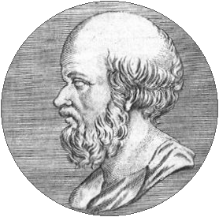
Sieve of Eratosthenes
ALGORITHM Sieve (n)
//Implements the Sieve of Eratosthenes
//Input: Integer n ≥ 2
//Output: List of primes less than or equal to n
for p ← 2 to n do A[p] ← p
for p ← 2 to ⎣n⎦ do
if A[p] ≠ 0 //p hasn’t been previously eliminated from the list j ← p* p
while j ≤ n do
A[j] ← 0 //mark element as eliminated
j ← j + p

Slide 10
FUNDAMENTALS OF ALGORITHMIC PROBLEM SOLVING

Slide 11
There are n locker doors in a hallway, numbered sequentially from 1 to n. Initially, all the locker doors are closed. You make n passes by the locker, each time starting with locker #1. On the i^{th} pass, I = 1, 2, …., n, you toggle the door of every i^{th} locker: if the door is closed, you open it; if it is open, you close it. After the last pass, which locker doors are open and which are closed? How many of them are open?

Slide 12
If we list all the natural numbers below 10 that are multiples of 3 or 5, we get 3, 5, 6 and 9. The sum of these multiples is 23. Find the sum of all the multiples of 3 or 5 below 1000.

Slide 13
IMPORTANT PROBLEM TYPES
Sorting
Searching
String Processing
Graph Problems
Combinatorial Problems
Geometric Problems
Numerical Problems
Notes:
1-4 have well known efficient (polynomial-time) solutions
5: primality testing has recently been found to have an efficient solution
This is a great problem to discuss because it has recently been in the news
(see mathworld news at: http://mathworld.wolfram.com/news/2002-08-07_primetest/
or original article: http://www.cse.iitk.ac.in/primality.pdf)
6(TSP)-9(chess) are all problems for which no efficient solution has been found
it is possible to informally discuss the “try all possibilities” approach that is required
to get exact solutions to such problems
10: Towers of Hanoi is a problem that has only exponential-time solutions (simply
because the output required is so large)
11: Program termination is undecidable

Slide 14
BUBBLE SORT

Slide 15
Bubble Sort – Idea
Compare adjacent elements of the list and exchange them if they are out of order.
By doing it repeatedly, we end up bubbling the largest element to the last position on the list.
The next pass bubbles up the second largest element and so on and after n – 1 passes, the list is sorted.
Pass i (0 ≤ i ≤ n – 2) can be represented as follows:
A[0], A[1], A[2], …, A[j] A[j+1], …, A[n-i-1] | A[n-i] ≤ …. ≤ A[n-1]

Slide 17
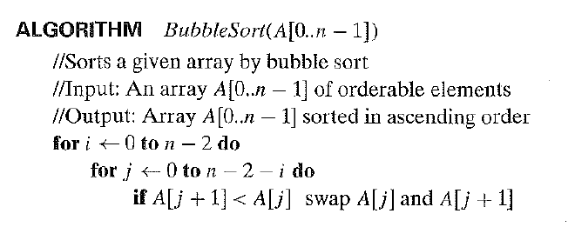
Bubble Sort - Algorithm

Slide 18
SEQUENTIAL SEARCH

Slide 19
Sequential Search – Idea
Compares successive elements of a given list with a given search key until:
A match is encountered (Successful Search)
List is exhausted without finding a match (Unsuccessful Search)
An improvisation to the algorithm is to append the key to the end of the list.
This means the search has to be successful always and we can eliminate the end of list check.

Slide 21
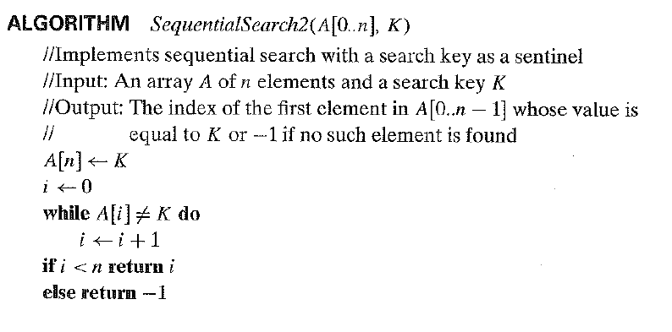
Sequential Search - Algorithm

Slide 22
BRUTE – FORCE STRING MATCHING

Slide 23
String Matching – Terms
pattern:
a string of m characters to search for
text:
a (longer) string of n characters to search in
problem:
find a substring in the text that matches the pattern

Slide 24
String Matching – Idea
Step 1 Align pattern at beginning of text
Step 2 Moving from left to right, compare each character of pattern to the corresponding character in text until:
all characters are found to match (successful search); or
a mismatch is detected
Step 3 While pattern is not found and the text is not yet exhausted, realign pattern one position to the right and repeat Step 2

Slide 25
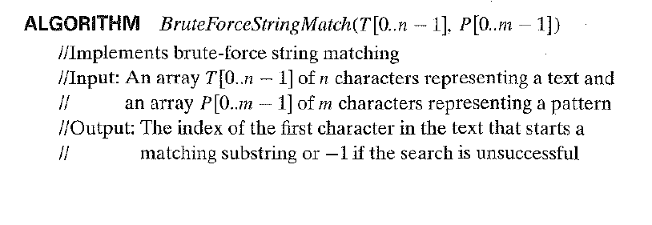
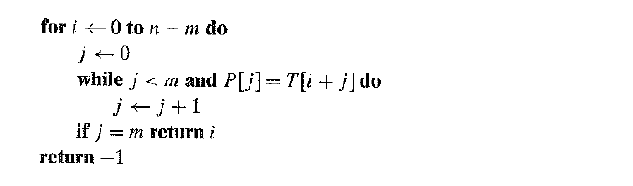
String Matching - Algorithm

Slide 26
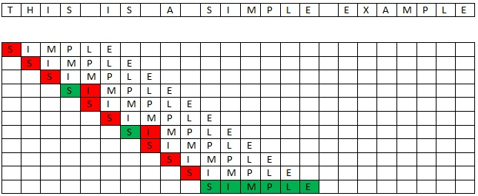

Slide 27
Fundamental data structures
List
Array
Linked List
String
Stack
Queue
Priority Queue
Graph
Tree
Set and Dictionary

Slide 28
Basic Issues Related to Algorithms
How to design algorithms
How to express algorithms
Proving correctness
Efficiency
Theoretical analysis
Empirical analysis
Optimality

Slide 29
FUNDAMENTALS OF THE ANALYSIS OF ALGORITHM EFFICIENCY

Slide 30
Algorithm design strategies
Brute force
Divide and conquer
Decrease and conquer
Transform and conquer
Greedy Approach
Dynamic Programming
Backtracking and Branch and Bound
Space and time tradeoffs

Slide 31
Analysis of Algorithms
How good is the algorithm?
Correctness
Time efficiency
Space efficiency
Does there exist a better algorithm?
Lower bounds
Optimality

Slide 32
ANALYSIS of ALGORITHMS (What and why)
Aspects of an Algorithm:
Correctness
Resource Consumption
Generality
Simplicity
… … …
Any and all of the above aspects can be analyzed to check if that aspect
is “acceptable” in the given “context”
Notes:
“I often say that when you can measure what you are speaking about and express it in numbers you know something about it; but when you cannot express it in numbers your knowledge is a meagre and unsatisfactory kind” – Lord Kelvin

Slide 33
GENERALITY, SIMPLICITY, …
Difficult to define precisely or quantify!
Generality:
Generality of problem solved
Range of inputs accepted
Simplicity:
Conceptual
Implementation
Aesthetics!

Slide 34
RESOURCE CONSUMPTION
Resources Consumed: Time, Space, Disk, Communication Bandwidth,…
Minimizing resource consumption is intuitively desirable!
Pragmatic Reasons also!!
We consider here only TIME!!! (well, some times, space also!)
Are these issues relevant in this era of fast computers, cheap
memory, broadband etc?
Notes:
“A designer knows he has arrived at perfection not when there is no longer anything to add, but when there is no longer anything to take away”. – Antoine de Saint Exupery
"In almost every computation a great variety of arrangements for the succession of the processes is possible, and various considerations must influence the selections amongst them for the purposes of a calculating engine. One essential object is to choose that arrangement which shall tend to reduce to a minimum the time necessary for completing the calculation“ – Ada Lovelace

Slide 35
Theoretical Analysis vs Empirical Analysis
Empirical Analysis:
Implement the algorithm in a specific language, execute it, and measure performance parameters of interest (generally, time but space and other parameters may also be of interest) aka “PROFILING”
Theoretical (a priori) Analysis:
Analyze performance of the algorithm independent of implementation in a specific programming language / execution platform!
Advantages / Disadvantages ?

Slide 36
Empirical analysis of time efficiency
Select a specific (typical) sample of inputs
Use physical unit of time (e.g., milliseconds)
or
Count actual number of basic operation’s executions
Code the algorithm in an actual programming language and validate it.
Run the program with the chosen input data
Analyze the empirical data
Not discussed any more!

Slide 37
Apriori Analysis ANALYSIS FRAMEWORK

Slide 38
Measuring an input’s size
Intuition: Most of the algorithms run longer on larger inputs.
Examples:
Sorting takes longer time for larger inputs
It takes more time to multiply larger matrices
Therefore, logically, we can calculate the efficiency of an algorithm as a function of ‘n’ which indicates the algorithm’s input size.

Slide 39
EXAMPLES FOR Measuring an input’s size
Sorting
Primality Testing
Computing the average of n numbers
Computing n/n!
Finding the largest element in a list of n numbers
Spell Checking
String Matching
Evaluating a polynomial
Reverse display a list of n numbers
Reverse a list of numbers

Slide 40
Theoretical analysis of time efficiency
Time efficiency is analyzed by determining the number of repetitions of the basic operation as a function of input size
Basic operation: the operation that contributes most towards the running time of the algorithm
T(n) ≈ c_{op *} C(n)
input size
running time
Number of times basic operation is executed
execution time
for basic operation

Slide 41
Input size and basic operation examples
Problem | Input size measure | Basic operation
Searching for key in a list of n items | Number of list’s items, i.e. n | Key comparison
Multiplication of two matrices | Matrix dimensions or total number of elements | Multiplication of two numbers
Checking primality of a given integer n | n’size = number of digits (in binary representation) | Division
Typical graph problem | #vertices and/or edges | Visiting a vertex or traversing an edge

Slide 42
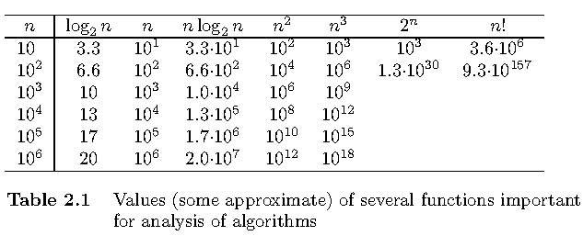
Values of some important functions as n → ∞

Slide 43
Best-case, average-case, worst-case
For some algorithms, efficiency depends on form of input:
Worst case: C_{worst}(n) – maximum over inputs of size n
Best case: C_{best}(n) – minimum over inputs of size n
Average case: C_{avg}(n) – “average” over inputs of size n
Number of times the basic operation will be executed on typical input
NOT the average of worst and best case
Expected number of basic operations considered as a random variable under some assumption about the probability distribution of all possible inputs. So, avg = expected under uniform distribution.

Slide 44
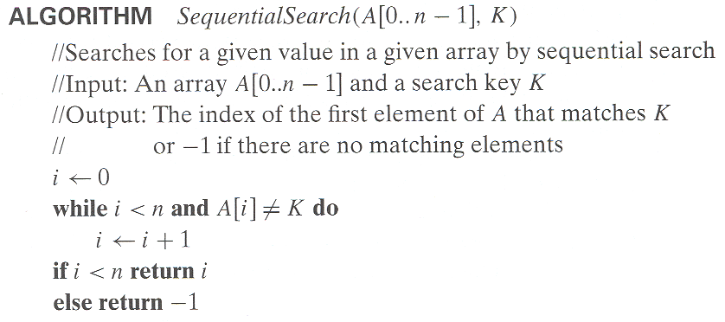
Example: Sequential search
Worst case | n key comparisons
Best case | 1 comparison
Average case | (n+1)/2, assuming K is in A

Slide 45
Sequential Search - Average Case (more)
Assume the probability of a successful search = p (o<=p<=1)
Key match can occur at any position with same probability
→ when the search is successful:
match occurring at any position i = p / n
and number of comparisons in such a case is i
Average Case Efficiency:
[1 (p/n) + 2 (p/n) + … + i (p/n) + … + n (p/n)] + n (1-p)
= (p/n) [1 + 2 + … + i + … + n] + n (1-p)
= (p/n) n (n+1) / 2 + n (1-p)
= [p (n+1) / 2] + [n (1-p)] ; check with p =0 and p=1

Slide 46
Types of formulas for basic operation’s count
Exact formula
e.g., C(n) = n(n-1)/2
Formula indicating order of growth with specific multiplicative constant
e.g., C(n) ≈ 0.5 n²
Formula indicating order of growth with unknown multiplicative constant
e.g., C(n) ≈ cn²

Slide 47
Order of growth
Most important: Order of growth within a constant multiple as n→∞
Example:
How much faster will algorithm run on computer that is twice as fast?
How much longer does it take to solve problem of double input size?
Notes:
Example: cn²
how much faster on twice as fast computer? (2)
how much longer for 2n? (4)

Slide 48
Asymptotic order of growth
A way of comparing functions that ignores constant factors and small input sizes (because?)
O(g(n)): class of functions f(n) that grow no faster than g(n)
Θ(g(n)): class of functions f(n) that grow at same rate as g(n)
Ω(g(n)): class of functions f(n) that grow at least as fast as g(n)

Slide 49
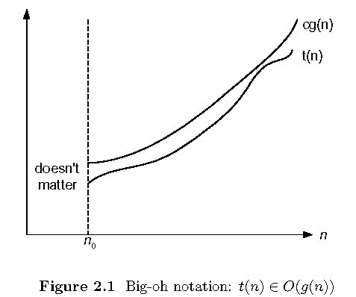
Big-oh

Slide 50
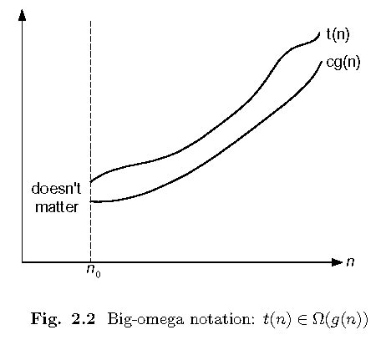
Big-omega

Slide 51
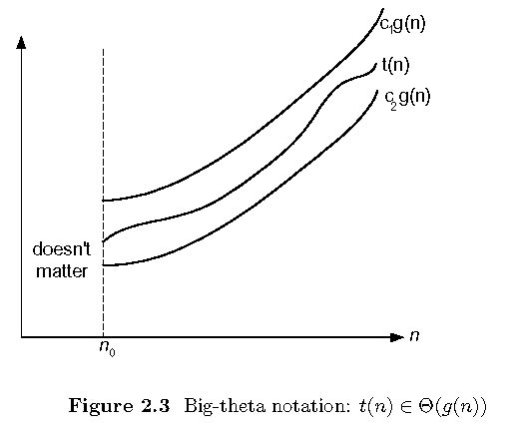
Big-theta

Slide 52
Establishing order of growth using the definition O - Notation
Definition:
f(n) is in O(g(n)), denoted by f(n) ∈ O(g(n)), if the order of growth of f(n) ≤ order of growth of a constant multiple of g(n), i.e., there exists a positive constant c and a non-negative integer n₀ such that
f(n) ≤ c g(n) for every n ≥ n₀
Examples:
10n is in O(n²)
5n+20 is in O(n)
Notes:
Examples:
10n is O(n²)
since 10n ≤ 10n² for n ≥ 1 or 10n ≤ n² for n ≥ 10
c n₀
5n+20 is O(10n)
since 5n+20 ≤ 10 n for n ≥ 4
c n₀

Slide 53
Ω-notation
Definition:
A function t(n) is said to be in Ω(g(n)), denoted t(n) ∈ Ω(g(n)), if t(n) is bounded below by some constant multiple of g(n) for all large n, i.e., if there exist some positive constant c and some nonnegative integer n₀ such that
t(n) ≥ cg(n) for all n ≥ n₀
Examples:
10n² ∈ Ω(n²)
0.3n² - 2n ∈ Ω(n²)
0.1n³ ∈ Ω(n²)

Slide 54
Θ-notation
Definition
A function t(n) is said to be in Θ(g(n)), denoted t(n) ∈ Θ(g(n)), if t(n) is bounded both above and below by some positive constant multiples of g(n) for all large n, i.e., if there exist some positive constant c₁ and c₂ and some nonnegative integer n₀ such that
c₂ g(n) ≤ t(n) ≤ c₁ g(n) for all n ≥ n₀
Examples:
10n² ∈ Θ(n²)
0.3n² - 2n ∈ Θ(n²)
(1/2)n(n+1) ∈ Θ(n²)

Slide 55
>=
Ω(g(n)), functions that grow at least as fast as g(n)
=
Θ(g(n)), functions that grow at the same rate as g(n)
g(n)
<=
O(g(n)), functions that grow no faster than g(n)

Slide 56
Theorem
If t₁(n) ∈ O(g₁(n)) and t₂(n) ∈ O(g₂(n)), then t₁(n) + t₂(n) ∈ O(max{g₁(n), g₂(n)}).
The analogous assertions are true for the Ω-notation and Θ-notation.
Implication: The algorithm’s overall efficiency will be determined by the part with a larger order of growth, i.e., its least efficient part.
For example, 5n² + 3nlogn ∈ O(n²)

Slide 57
Theorem
Proof. There exist constants c1, c2, n1, n2 such that
t1(n) ≤ c1*g1(n), for all n ≥ n1
t2(n) ≤ c2*g2(n), for all n ≥ n2
Define c3 = c1 + c2 and n3 = max{n1,n2}.
Then:
t1(n) + t2(n) ≤ c3*max{g1(n), g2(n)}, for all n ≥ n3

Slide 58
Some properties of asymptotic order of growth
f(n) ∈ O(f(n))
f(n) ∈ O(g(n)) iff g(n) ∈Ω(f(n))
If f (n) ∈ O(g (n)) and g(n) ∈ O(h(n)) , then f(n) ∈ O(h(n)) Note similarity with a ≤ b
If f₁(n) ∈ O(g₁(n)) and f₂(n) ∈ O(g₂(n)) , then
f₁(n) + f₂(n) ∈ O(max{g₁(n), g₂(n)})
Also, Σ_{1≤i≤n} Θ(f(i)) = Θ (Σ_{1≤i≤n} f(i))
Exercise: Can you prove these properties?

Slide 59
Establishing order of growth using limits
0 order of growth of T(n) < order of growth of g(n)
lim T(n)/g(n) =
c > 0 order of growth of T(n) = order of growth of g(n)
n→∞
∞ order of growth of T(n) > order of growth of g(n)
Examples:
10n vs. n² n(n+1)/2 vs. n²

Slide 60
L’Hôpital’s rule and Stirling’s formula
L’Hôpital’s rule: If lim_{n→∞} f(n) = lim_{n→∞} g(n) = ∞ and
the derivatives f´, g´ exist, then
Stirling’s formula: n! ≈ (2πn)^{1/2} (n/e)^{n}
f(n)
g(n)
f ´(n)
g ´(n)
lim
n→∞
=
lim
n→∞
Example: log n vs. n
Example: 2^{n} vs. n!

Slide 61
Orders of growth of some important functions
All logarithmic functions log_{a} n belong to the same class
Θ(log n) no matter what the logarithm’s base a > 1 is
All polynomials of the same degree k belong to the same class:
a_{k}n^{k} + a_{k-1}n^{k-1} + … + a₀ ∈ Θ(n^{k})
Exponential functions a^{n} have different orders of growth for different a’s
order log n < order n^{α} (α>0) < order a^{n} < order n! < order n^{n}

Slide 62
Basic asymptotic efficiency classes
1 | constant
log n | logarithmic
n | linear
n log n | n-log-n
n² | quadratic
n³ | cubic
2^{n} | exponential
n! | factorial

Slide 63
Time efficiency of non - recursive algorithms
General Plan for Analysis
Decide on parameter n indicating input size
Identify algorithm’s basic operation
Determine worst, average, and best cases for input of size n
Set up a sum for the number of times the basic operation is executed
Simplify the sum using standard formulas and rules (see Appendix A)

Slide 64
Useful summation formulas and rules
Σ_{l≤i≤u}1 = 1+1+…+1 = u - l + 1
In particular, Σ_{l≤i≤u}1 = n - 1 + 1 = n ∈ Θ(n)
Σ_{1≤i≤n} i = 1+2+…+n = n(n+1)/2 ≈ n²/2 ∈ Θ(n²)
Σ_{1≤i≤n} i² = 1²+2²+…+n² = n(n+1)(2n+1)/6 ≈ n³/3 ∈ Θ(n³)
Σ_{0≤i≤n} a^{i} = 1 + a +…+ a^{n} = (a^{n+1} - 1)/(a - 1) for any a ≠ 1
In particular, Σ_{0≤i≤n} 2^{i} = 2⁰ + 2¹ +…+ 2^{n} = 2^{n+1} - 1 ∈ Θ(2^{n} )
Σ(a_{i} ± b_{i} ) = Σa_{i} ± Σb_{i} Σca_{i} = cΣa_{i} Σ_{l≤i≤u}a_{i} = Σ_{l≤i≤m}a_{i} + Σ_{m+1≤i≤u}a_{i}

Slide 65
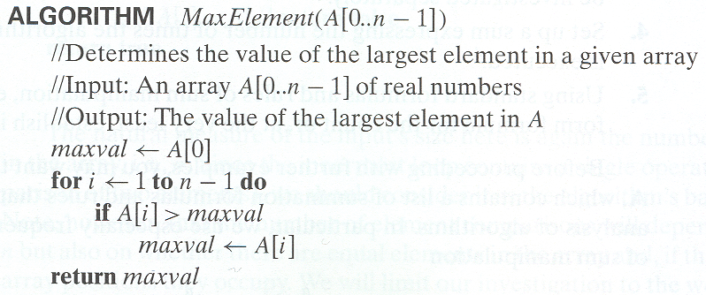
Example 1: Maximum element

Slide 66
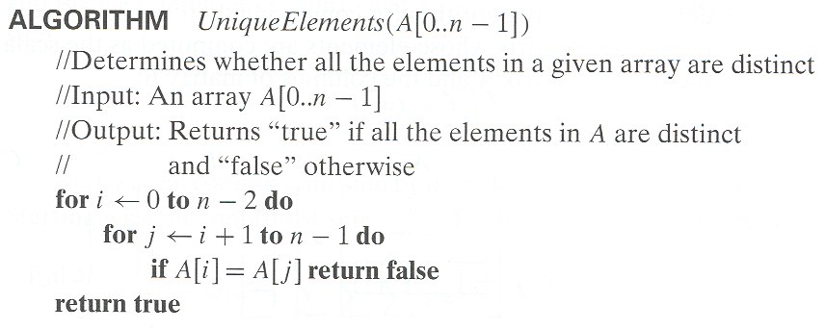
Example 2: Element uniqueness problem

Slide 67
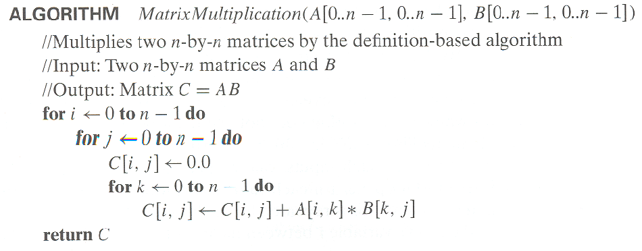
Example 3: Matrix multiplication

Slide 68
Example 4: Gaussian elimination
ALGORITHM GaussianElimination(A[0..n-1,0..n])
//Implements Gaussian elimination of an n-by-(n+1) matrix A
for i ← 0 to n - 2 do for j ← i + 1 to n - 1 do for k ← i to n do
A[j,k] ← A[j,k] - A[i,k] ∗ A[j,i] / A[i,i]
Find the efficiency class and a constant factor improvement.

Slide 69
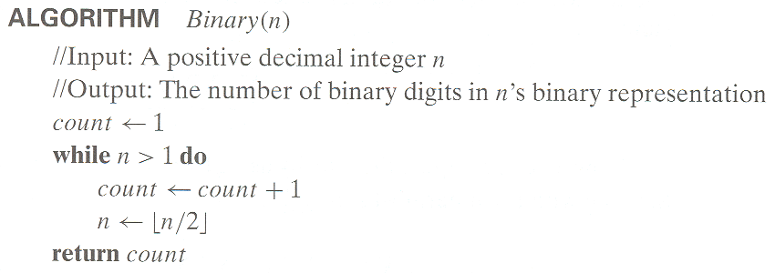
Example 5: Counting binary digits

Slide 70
Plan for Analysis of Recursive Algorithms
Decide on a parameter indicating an input’s size.
Identify the algorithm’s basic operation.
Check whether the number of times the basic op. is executed may vary on different inputs of the same size. (If it may, the worst, average, and best cases must be investigated separately.)
Set up a recurrence relation with an appropriate initial condition expressing the number of times the basic op. is executed.
Solve the recurrence (or, at the very least, establish its solution’s order of growth) by backward substitutions or another method.

Slide 71
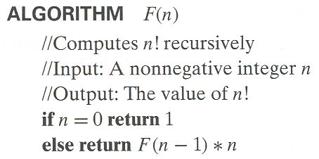
Example 1: Recursive evaluation of n!
Definition: n ! = 1 ∗ 2 ∗ … ∗(n-1) ∗ n for n ≥ 1 and 0! = 1
Recursive definition of n!: F(n) = F(n-1) ∗ n for n ≥ 1 and
F(0) = 1
Notes:
Note the difference between the two recurrences. Students often confuse these!
F(n) = F(n-1) n
F(0) = 1
for the values of n!
------------
M(n) =M(n-1) + 1
M(0) = 0
for the number of multiplications made by this algorithm

Slide 72

Solving the recurrence for M(n)
M(n) = M(n-1) + 1, M(0) = 0

Slide 73
Example 2: The Tower of Hanoi Puzzle
M(n) = 2(M(n-1)) + 1

Slide 74
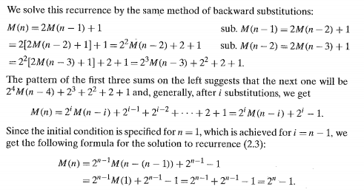
Solving recurrence

Slide 75
Tree of calls for the Tower of Hanoi Puzzle

Slide 76
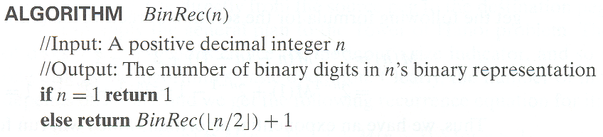
Example 3: Counting #bits

Slide 77
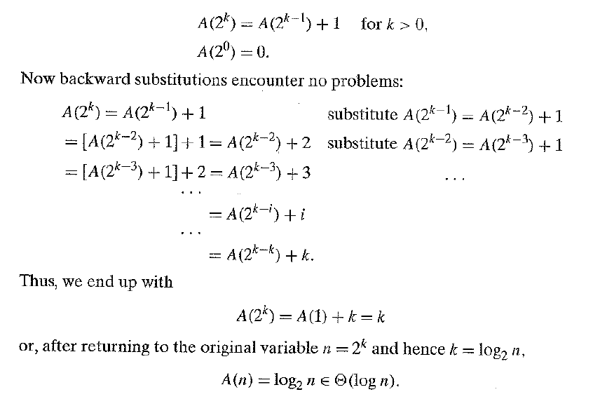

Slide 78
Fibonacci numbers
The Fibonacci numbers:
0, 1, 1, 2, 3, 5, 8, 13, 21, …
The Fibonacci recurrence:
F(n) = F(n-1) + F(n-2)
F(0) = 0
F(1) = 1
General 2nd order linear homogeneous recurrence with
constant coefficients:
aX(n) + bX(n-1) + cX(n-2) = 0

Slide 79
Solving aX(n) + bX(n-1) + cX(n-2) = 0
Set up the characteristic equation (quadratic)
ar² + br + c = 0
Solve to obtain roots r₁ and r₂
General solution to the recurrence
if r₁ and r₂ are two distinct real roots: X(n) = αr₁^{n} + βr₂^{n}
if r₁ = r₂ = r are two equal real roots: X(n) = αr^{n} + βnr ^{n}
Particular solution can be found by using initial conditions

Slide 80
Application to the Fibonacci numbers
F(n) = F(n-1) + F(n-2) or F(n) - F(n-1) - F(n-2) = 0

Slide 81
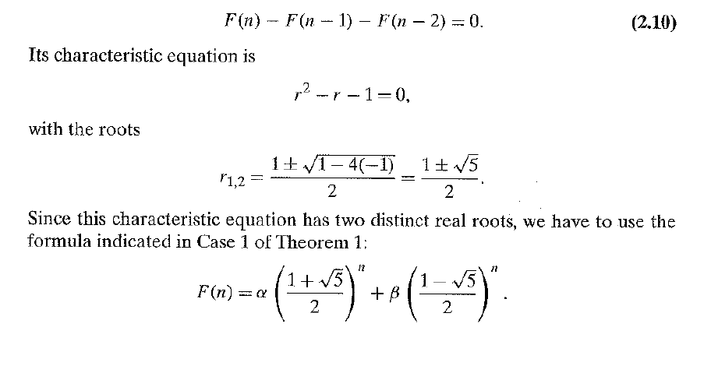

Slide 82
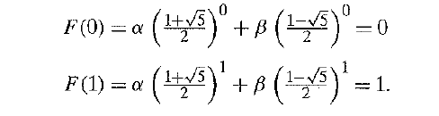

Since the characteristic equation has two distinct real roots:

Slide 83
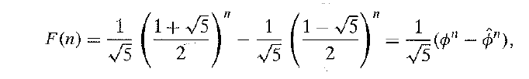


Slide 84
Computing Fibonacci numbers
Definition-based recursive algorithm
Nonrecursive definition-based algorithm
Explicit formula algorithm
Logarithmic algorithm based on formula:
n
F(n-1) F(n)
0 1
=
F(n) F(n+1)
1 1
for n≥1, assuming an efficient way of computing matrix powers.

